Slide 1

UNIT-II FIBER OPTICS
Dr.A.Sivakami,
Associate Professor,
Department of Physics,
Malla Reddy University, Hyderabad.

Slide 2
Unit-II: Fiber optics
FIBER OPTICS: Introduction to optical fiber, Construction and working principle of an Optical Fiber, Acceptance angle and numerical aperture, Types of Optical fibers - Mode and Propagation through step and graded index fibers, Attenuation in optical fiber, Applications of optical fibers: Optical fiber communication system, Medical, Sensors: Temperature and liquid level sensors

Slide 3
BASED on refractive index profile combining with modes of fiber
Step index fibers
Step index Step index multimode fiber
single mode fiber
2. Graded Index Fiber [GRIN fiber]
Graded index multimode fiber

Slide 4
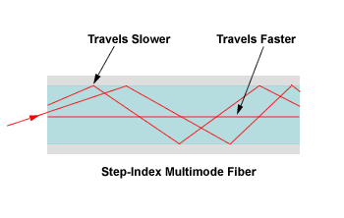
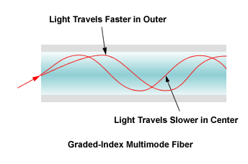
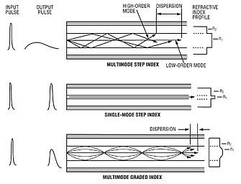

Slide 5
STEP INDEX fibers
Definition: In optical fiber, a step index fiber is a fiber characterized by a uniform refractive index within the core and a sharp decrease in refractive index at the core-cladding interface so that the cladding is of a lower refractive index. In a step index fiber, the light rays propagate in zig-zag manner inside the core. The rays travel in the fiber as meridional rays and they cross the fiber axis for every reflection.

Slide 6
STEP INDEX fibers
In single mode step index fiber, there is no distortion. The Step index fiber has a lower bandwidth. The bandwidth is about 50 MHz km for multimode step index fiber whereas it is more than 100 MHz km in case of single mode step index fiber.
The refractive index profile in a step index fibers with radius r represented as,
n(r)=n1 if r<a inside core
= n2 if r>a in cladding

Slide 7
Step index SMF

Slide 8
CHARACTERISTICS OF step index SMF
Step index fiber is a fiber in which the core is of a uniform refractive index and there is a sharp decrease in the index of refraction at the cladding.
Step index fiber is found in two types, that is mono mode fiber and multi mode fiber.
Index profiles are in the shape of step.
The light rays propagate in zig–zag manner inside the core. The rays travel in the fiber as meridional rays and they cross the fiber axis for every reflection.
Signal distortion is more in case of high-angle rays in multimode step index fiber. In single mode step index fiber, there is no distortion.

Slide 9
CHARACTERISTICS OF step index SMF
The fiber has lower bandwidth. The bandwidth is about 50 MHz km for multimode step index fiber whereas it is more than 100 MHz km in case of single mode step index fiber.
The diameter of the core is between 50-200µm in the case of multimode fiber and 10µm in the case of single mode fiber.
Used for short distance communication.
Attenuation of light rays is more in multimode step index fibers but for single mode step index fibers, it is very less.
Less expensive.
NA of multimode step index fiber is more whereas in single mode step index fibers, it is very less.
Pulse broadening and inter modal dispersion is present.

Slide 10
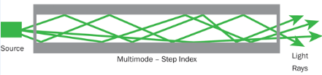
Transmission of light signal in step index fibers
Light travels along a side path, i.e., along the axis only. So zero order modes is supported by Single Mode Fiber
Step-index multimode fibers operate on the principle of total reflection and allow traveling of light across the fiber/core axis in a zigzag pattern.

Slide 11
Transmission of light signal in step index fibers
Light entering the step-index multimode fiber at different incidence angles will pass through different paths ensuring effective multimode operation. Each light beam travels at the same speed across the fiber however the time it takes to exit depends on the angle at which it entered.

Slide 12
Graded index fiber or GRIN fiber
Definition: Graded Index fiber is another type of optical fiber in which the refractive index of the core is non-uniform. This non-uniformity is present because the refractive index is higher at the axis of the core and continuously reduces with the radial movement away from the axis.
However, the refractive index of the cladding is constant in the case of graded index fiber. Hence the nature of the refractive index of the core is somewhat parabolic.
Unlike graded index optical fiber, the step index fiber has a constant refractive index at the core as well as cladding

Slide 13
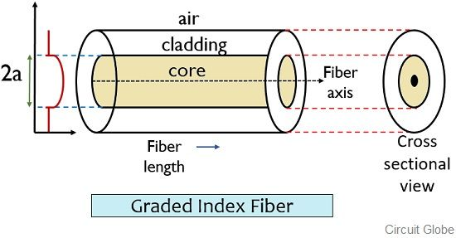
GRIN Fiber

Slide 14
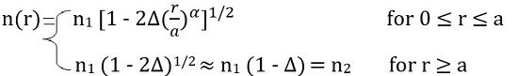
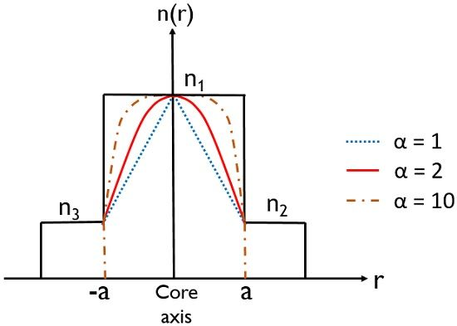
In this type of fiber, the light ray experiences refraction thus gets bent towards the core. Thereby allowing propagation of ray in a curved path.
The refractive index of graded index fiber in the mathematical term is expressed as:
Where a radius of the core shows characteristics of refractive index profile
R radial distance from the core axis

Slide 15
Transmission of light signal in GRIN fiber

Slide 16
In graded index fiber, light rays travel at different speeds in different parts of the fiber because the refractive index varies through out the fiber. Near the outer edge, the refractive index is lower. As a result, rays near the outer edge travel faster than the rays at the center of the core. Because of this, rays arrive at the end of the fiber at approximately the same time.
The reflected rays travels back towards the core axis and without crossing the fiber axis, it is refracted towards downwards direction and again gets totally internally reflected and passes towards upward direction. In this manner the ray propagates inside the fiber in a helical or spiral manner.

Slide 17
Characteristics of GRIN fiber
Graded index fiber is a type of fiber where the refractive index of the core is non-uniform at the center core and then it decreases towards core-cladding interface.
Graded index fiber is of only one type, that is, multi mode fiber.
Index profiles is in the shape of a parabolic curve (for α=2).
The light rays propagate in the form of skew rays or helical rays. They will not cross the fiber axis.
Signal distortion is very low even though the rays travel with different speeds inside the fiber.

Slide 18
Characteristics of GRIN fiber
The fiber has higher bandwidth. The bandwidth of the fiber lies in between 200 MHz Km to 600 MHz km even though theoretically it has an infinite bandwidth.
The diameter of the core is about 50µm in the case of multimode fiber.
Used for long distance communication.
Attenuation of light rays is less in graded index fibers.
Highly expensive.
NA of graded index fibers is less.
No pulse broadening and inter modal dispersion due to periodic self focusing.

Slide 19
Difference between STEP INDEX & GRIN FIBER
BASIS OF COMPARISON | STEP INDEX FIBER | GRADED INDEX FIBER
Definition | Step index fiber is a fiber in which the core is of a uniform refractive index and there is a sharp decrease in the index of refraction at the cladding | Graded index fiber is a type of fiber where the refractive index of the core is maximum at the center core and then it decreases towards core-cladding interface
Types | Step index fiber is found in two types, that is mono mode fiber and multi mode fiber. | Graded index fiber is of only one type, that is, multi mode fiber.
Index Profiles | Index profiles are in the shape of step. | Index profiles is in the shape of a parabolic curve
Light Rays Propagation | The path of light propagation is zig- zag in manner. The light ray propagation is in the form of meridional rays and it passes through the fiber axis. | The path of light is helical in manner. The light propagation is in the form of skew rays and it will not cross fiber axis.

Slide 20
Difference between STEP INDEX & GRIN FIBER
BASIS OF COMPARISON | STEP INDEX FIBER | GRADED INDEX FIBER
Signal Distortion | Signal distortion is more in case of high-angle rays in multimode step index fiber. In single mode step index fiber, there is no distortion. | Signal distortion is very low even though the rays travel with different speeds inside the fiber.
Bandwidth Size & Cost | The fiber has lower bandwidth. Less expensive | The fiber has higher bandwidth. Higher expensive.
Diameter Of The Core | The diameter of the core is between 50-200µm in the case of multimode fiber and 10µm in the case of single mode fiber. | The diameter of the core is about 50µm in the case of multimode fiber.
Attenuation | Attenuation is more for multimode step index fiber but for single mode it is very less. | Attenuation is less.
Application | Used for short distance communication. | Used for long distance communication.

Slide 21
losses in Optical fiber
As light signal propagate through a fiber, it suffers loss of amplitude and change in shape. The loss of amplitude is referred to as attenuation and the change in shape as dispersion.

Slide 22
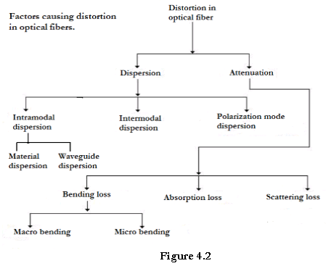

Slide 23
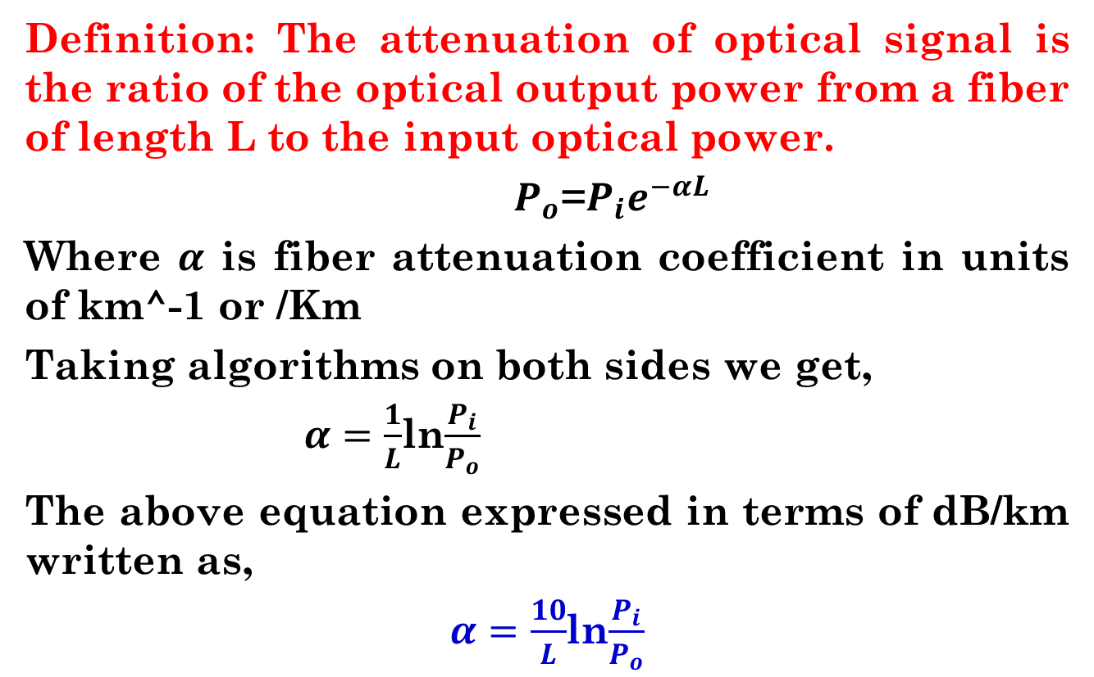
ATTENUATION IN OPTICAL FIBER

Slide 25
Types of Attenuation
Attenuation
Intrinsic Attenuation
Extrinsic Attenuation
Losses occurring inside the optical fiber such as defects or impurities, variations in material density (refractive index) present in the core material. Ex. Water, metals
Losses occurring in outside the optical fiber i.e. Physical stress on the fiber
Absorption loss
Rayleigh Scattering loss
Macrobend loss
Microbend loss

Slide 26
Intrinsic attenuation-Absorption loss
Absorption by material: It is a major cause of signal loss in an optical fiber resulting from the conversion of optical energy into some other energy like heat.
Usually absorption of light occurs due to imperfections of the atomic structure such as missing molecules, (OH-), hydroxyl ions, high density cluster of atoms etc., which absorbs light

Slide 27
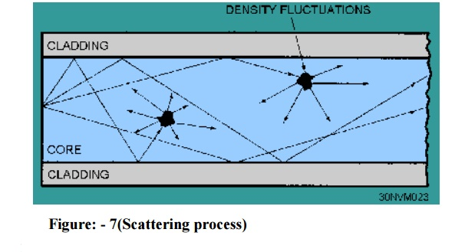
Absorption and scattering losses in optical fiber

Slide 28
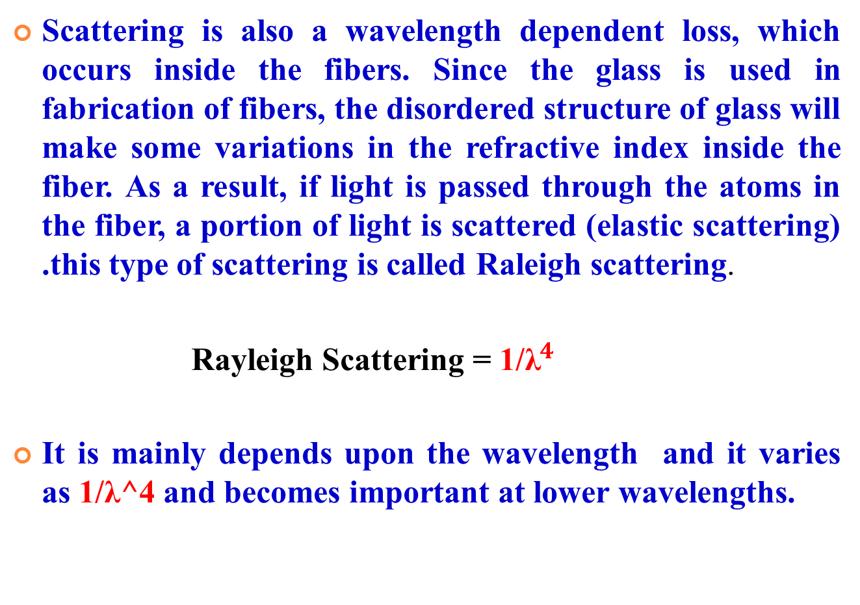
Intrinsic attenuation-scattering loss

Slide 29
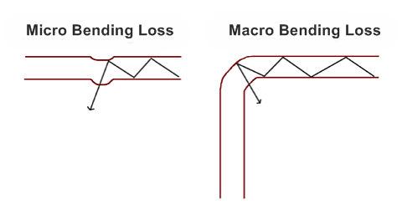
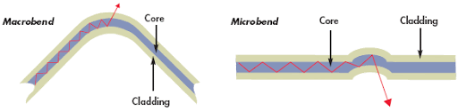
Extrinsic attenuation or bending losses in optical fiber
It is classified according to the bending of finite radius of curvature in optical fibers. i.e micro bend and macro bend loss.
It’s usually caused by improper handling of fibre optic cable

Slide 30
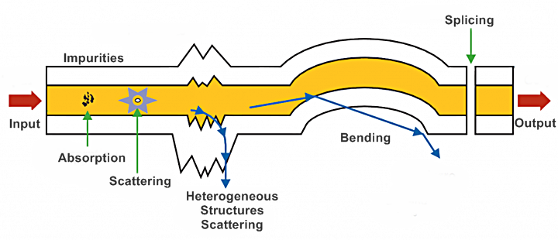

Slide 31
Macro bending loss: outside the fiber
If the radius of the core is large compared to fiber diameter, it may cause large-curvature at the position where the fiber cable turns at the corner. At these corners the light will not satisfy the condition for total internal reflection and hence it escapes out from the fiber. This is called as macroscopic / macro bending losses. Also note that this loss is negligible for small bends.
It is visible to us.
Micro bending loss: inside the fiber
Micro-bends losses are caused due to non-uniformities or micro bends inside the fiber as shown. This micro bends in fiber appears due to non uniform pressures created during the cabling of the fiber or even during the manufacturing itself. This lead to loss of light by leakage through the fiber.
It is invisible to us

Slide 32
Applications of fiber
Due to advantages of optical fiber, it is used in wide range of application in different fields namely:
Communication
Medicine and
Sensors etc.,

Slide 33
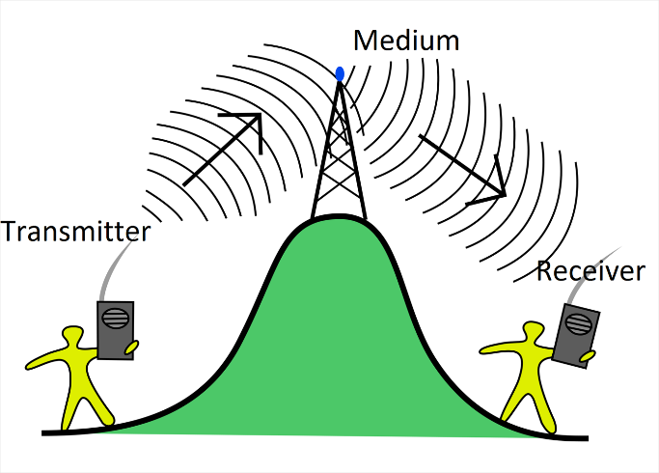
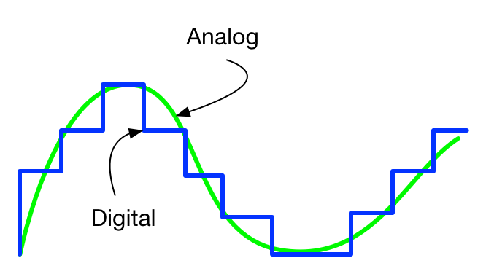
Communication systems
The major elements of communication are the Transmitter of information, Channel or medium of communication and the Receiver of information.
Wired (lined) communication: OF communication etc. (light)
Wireless (Space) communication: Satellite communication etc.(electrons)

Slide 34
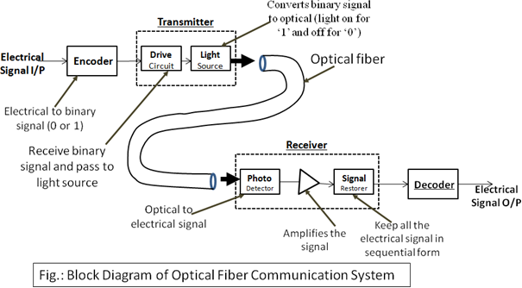
Optical fiber communication system (OFCS)

Slide 35
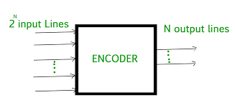
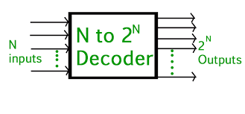
Encoder & decoder An encoder is a circuit that changes a set of signals into a code A decoder is a circuit that changes a code into a set of signals

Slide 36
Parts of OFCS
Encoder: The audio signal (i.e., the words spoken by us) is converted into electrical signal which is an analog signal. Encoder is an electronic circuit that converts this analog signal into binary or digital signals.
Transmitter: The digital signal from the encoder is fed to the transmitter which consists of two parts- Drive circuit and Light source. Drive circuit receives the digital signal from encoder and feeds it to the light source. Light source is usually LED or a Diode LASER. If digital ‘0’ is received then light source will be turned OFF. If digital ‘1’ is received then the light source will be turned ON. Thus light source converts electrical signals into optical signals.

Slide 37
Parts of OFCS
c) Waveguide: Now the Optical signals generated by the transmitter are fed to an optical fiber which acts as waveguide. The signal travels over longer distances through these waveguides.
d)Receiver: On the other side of the waveguide, the optical signal is received by the receiver which consists of Photo detector, amplifier and a signal restorer. The Photo detector receives the optical signal and generates the equivalent electrical signals. These electrical signals are amplified by the amplifier. The signal restorer keeps all the electrical signals in a sequential form and supplies to decoder.
e) Decoder: It is an electronic system that converts the
digital signal to analog signal.

Slide 38
Medical Endoscope
Optical fibers are very mush useful in medical field.
Using low quality, large diameter and short length silica fibers we can design a fiber optic endoscope or fibroscope.
A medical endoscope is a tubular optical instrument, used to inspect or view the inner parts of the human body which are not visible to the naked eye.
The photograph of internal parts can also be taken using in this endoscope.

Slide 39
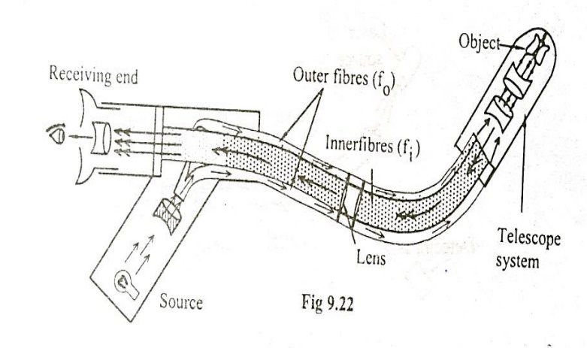
Construction

Slide 40
Construction of Medical Endoscope
Outer fiber: The outer fiber consists of many fibers bundled together without any particular order of arrangement and is called incoherent bundle. These fiber bundles as a whole are enclosed in a thin sleeve for protection. The outer fiber is used to illuminate or focus the light onto the inner parts of the body.
Inner fiber: The inner fiber also consists of a bundle of fibers, but in perfect order. Therefore this arrangement is called coherent bundle. This fiber is used to collect the reflected light from the object. A tiny lens is fixed to one end of the bundle in order to effectively focus the light, reflected from the object. For a wider field of view and better image quality, a telescope system is added in the internal part of the telescope.

Slide 41
Working of Medical Endoscope
Light from the source is passed through the outer fiber (f0). The light is illuminated on the internal part of the body. The reflected light from the object is brought to focus using the telescope to the inner fiber (fi)
Here each fiber picks up a part of the picture from the body. Hence the picture will be collected bit by bit and is transmitted in an order by the array of fibers. As a result, the whole picture is reproduced at the other end of the receiving fiber as shown in the figure. The output is properly amplified and can be viewed through the eye piece at the receiving end.

Slide 42
Working of Medical Endoscope
The cross sectional view is as shown in the figure. In figure, we can see that along with input and output fibers, we have two more channels namely,
(i) Instrumental Channel (C1) and
(ii) Irrigation channel (C2) used for the following purposes.
Instrumentation channel (C1): It is used to insert or take the surgical instruments needed for operation.
Irrigation channel (C2): It is used to blow air or this is used to clear the blood in the operation region, so that the affected parts of the body can be clearly viewed.

Slide 43
sensors
A sensor is a device that detects and responds to some type of input from the physical environment. The input can be light, heat, motion, moisture, pressure or any number of other environmental phenomena. The output is generally a signal that is converted to a human-readable display at the sensor location or transmitted electronically over a network for reading or further processing.
(OR)
A sensor is defined as a device or a module that helps to detect any changes in physical quantity like pressure, force, temperature, displacement and electrical quantity like current or any other form of energy. After observing the changes, sensor sends the detected input to a microcontroller or microprocessor

Slide 44
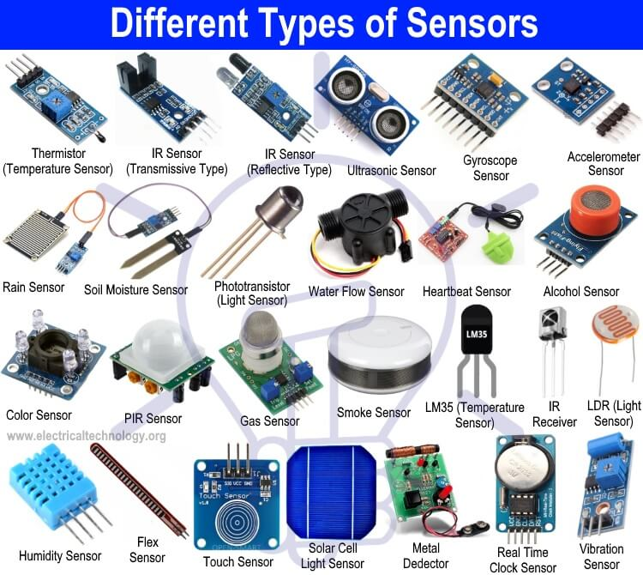
Applications of OF: Level Sensors

Slide 45
Classification of sensors
Based on
Sensing location-Intrinsic and extrinsic
Operating Principle-intensity, phase, wavelength, polarization
Application-physical sensors, chemical sensors & biomedical sensors
Response to the measurement point-point to point sensor and Multiplex sensors 5

Slide 46
Temperature Sensor
Principle
It is based on the principle of interference between the beams emerging out from the reference fiber and the fiber kept in the measuring environment.
Construction
It consists of a Laser source to emit light. A beam splitter, made of glass plate is inclined at an angle 45 degree with respect to the direction of the laser beam.

Slide 47
Construction-Temperature Sensor
Two fibers viz, i. Reference fiber which is isolated from the environment
ii. Test fiber kept in the environment to be sensed, are placed as shown in the figure. Separate lens systems are provided to split and to collect the beam.

Slide 48
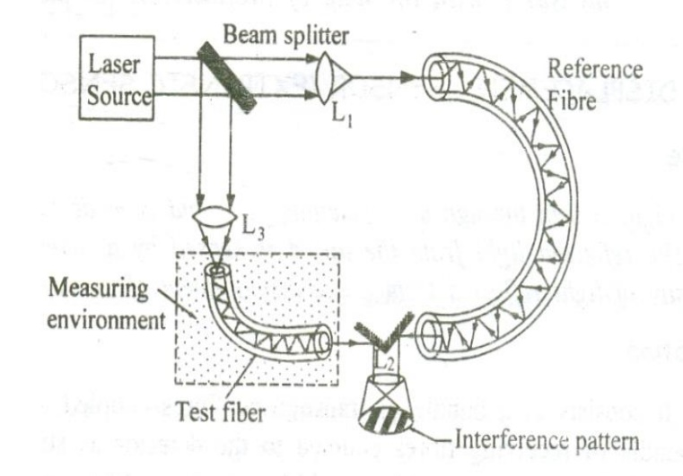
Construction-Temperature Sensor

Slide 49
Working:
1. A monochromatic source of light is emitted from the laser source.
2. The beam splitter kept at an angle 45 degree inclination divides the beam emerging from the laser source into two beams (i) main beam and (ii) splitted beam, exactly at right angles to each other.
3. The main beam passes through the lens L1 and is focused onto the reference fiber which is isolated from the environment to be sensed.
4. The beam after passing through the reference fiber then falls on the Lens L2.
5. The splitted beam passes through the Lens L3 and is focused onto the test fiber kept in the environment to be sensed.
6. The splitted beam after passing through the test fiber is made to fall on lens L2.

Slide 50
7. The two beams after passing through the fibers, produces a path difference due to change in parameters such as pressure, temperature etc in the environment.
8. Therefore a path difference is produced between two beams causing the interference pattern as shown in the figure.
9. Thus the change in pressure or temperature can be accurately measured with the help of the interference pattern obtained.

Slide 51
Liquid Level Sensor
A fiber optic sensor in general, consists of a light source. The light source is coupled to an optical fiber. A light detector which receives the signal – carrying light beam is as it emerges from the fiber.
Liquid level sensor consists of two fibers which are connected at the base of a glass micro prism. When the tip of the prism is immersed in the liquid, there is no output at the detector. When the tip of the prism is just above the liquid level, due to contact with air, there is total internal reflection and output is got in the detector

Slide 53
Liquid Level Sensor
Fiber optic liquid-level sensors can be classified in the following two categories: sensors for continuous measurements and sensors for point measurements. It is based on the total internal reflection of light, which is disturbed by contact with liquid. The system includes an electronic control unit with a transmitter and a receiver, a sensor, and two fibers. A chamfered Optical fiber, containing of core alone is used in a level sensor. The condition here is that the refractive indices of air, core and liquid should such that n_{air} < n_{core}< n_{liquid}.

Slide 54
Liquid Level Sensor
A light signal from the source is fed to the fiber core as shown in fig. (i). The light signal reaches the detector after getting subjected to total internal reflections in the core. It is observed here that the liquid level did not touch the tip of the optical fiber yet and hence the light signal smoothly reaches the detector.
When the liquid raises to sufficient level as shown in figure (ii), at the point of core-liquid interface, total internal reflection cannot take place. The reason is n_{core}< n_{liquid}. Therefore, the light signal gets leaked into liquid without reaching the detector.Thus, the light signal reaching the detector indicates lower liquid level while the detector does not receive the light signal, indicates sufficient level of the liquid.

Slide 55
Problems

Slide 66
THANK YOU

